Slide 1
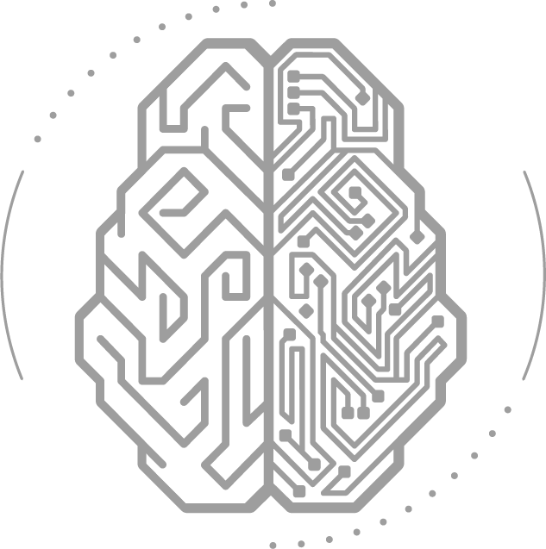
MLOps Pipelines and Architecture

Slide 2
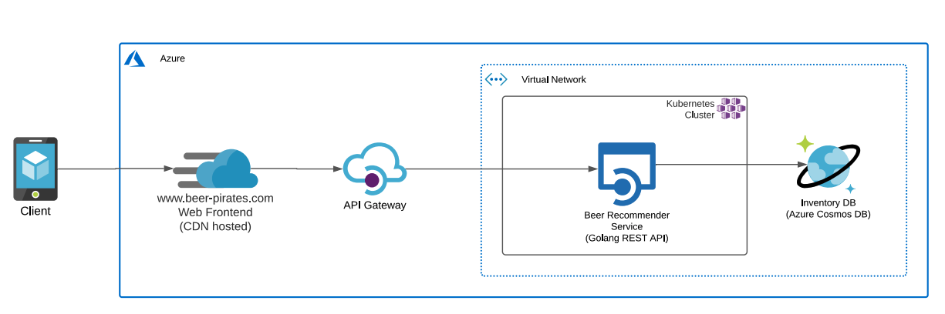
Objective & Background
Seamless ML integration: No frontend changes while backend services can be adjusted. New ML versions should not interrupt the frontend.
Infrastructure rollout: Ensure effective training in terms of runtime and cost.
Automation focus: GitOps approach for software lifecycle management.
Proposed solution: Utilize AWS for MLOps platform and endpoint, leveraging familiarity while keeping the frontend on Azure CDN, interacting with the AWS-hosted API.

Slide 3
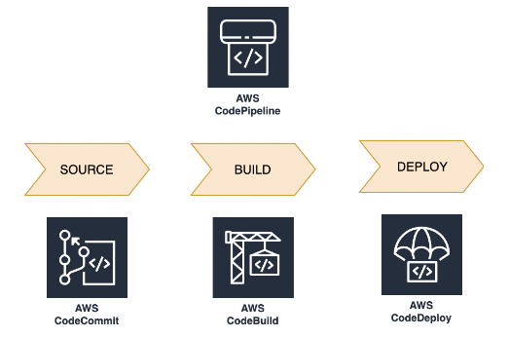
CI/CD and Automation
Utilize CodePipeline, CodeCommit, and CodeBuild for Continuous Integration and Continuous Deployment (CI/CD) automation.
After code is merged/pushed to the main branch, CodeBuild is triggered for operation like unit testing, containerization, submission of new job and deployment.

Slide 4
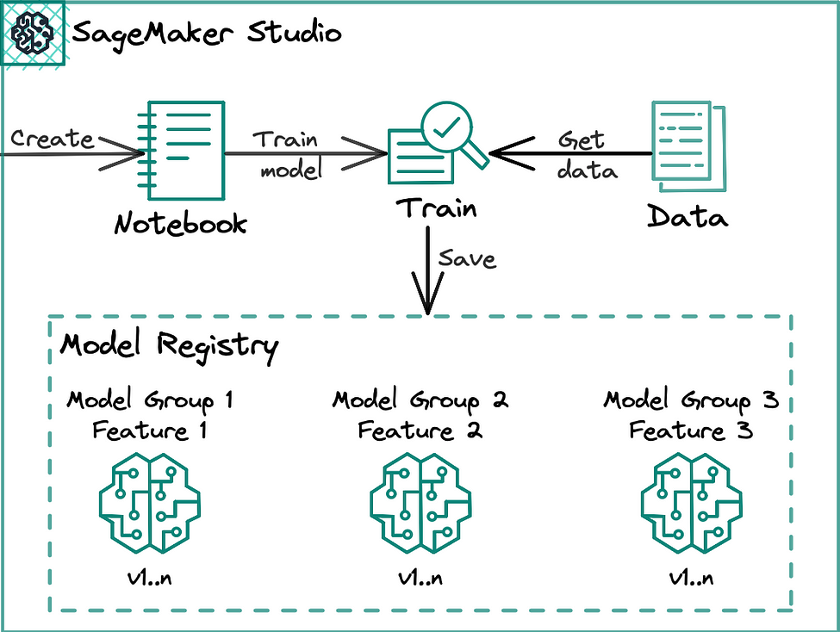
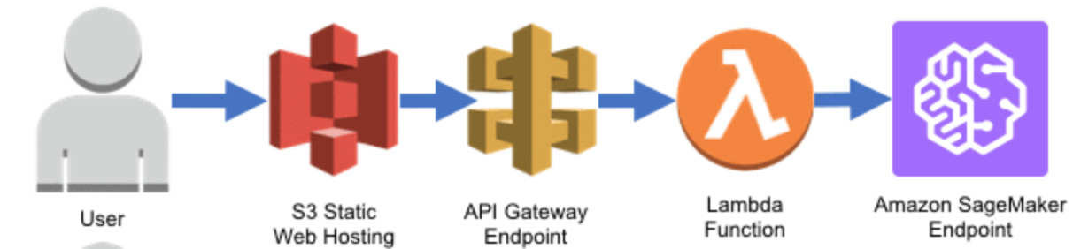
Seamless Training and Deployment
Automated Model Training: SageMaker training and processing jobs auto-triggered via CodeBuild.
Model Approval Process: Uploaded model requires user approval in the model registry.
Auto-Rollback Mechanism: If issues arise, SageMaker triggers auto rollback to the previous fleet, ensuring endpoint availability and minimizing production impact.
ECR Image
Approval

Slide 5
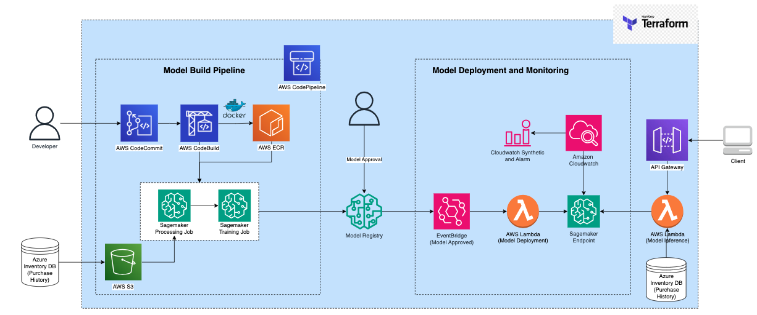
Proposal
www.peer-pirates.com
Web Frontend
Secure File
Transfer

Slide 6
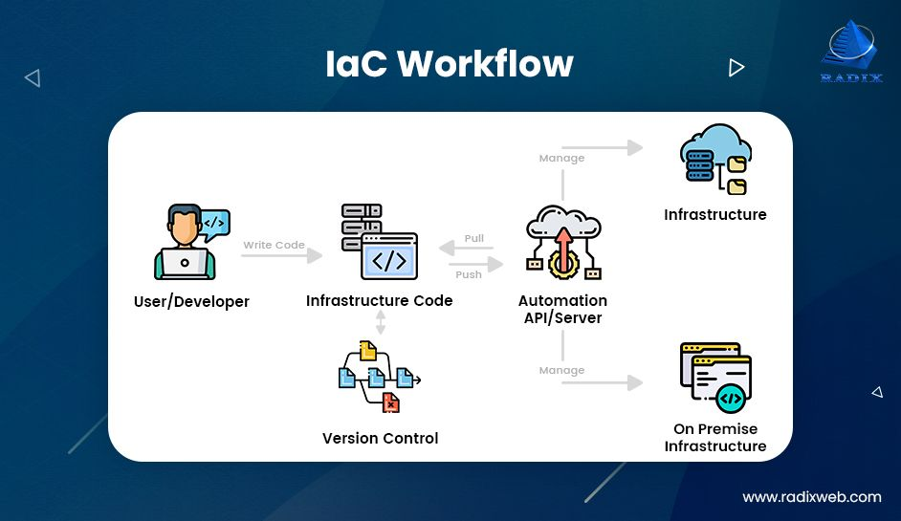
Infra as Code - Terraform
Infrastructure as Code (IaC) enables infrastructure provisioning and management through code, offering repeatability, consistency, and version control.
Allows for orchestration of the entire infrastructure lifecycle, from creation to modification to decommissioning.
Terraform supports multiple cloud providers (AWS, Azure, Google Cloud, etc.) and various services within these providers.
Supports collaboration by enabling teams to work on the same infrastructure codebase.

Slide 7
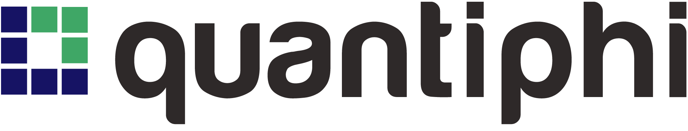
Q & A

Slide 8
Code Base Presentation

Slide 9
THANK YOU

